Slide 1
Lab 3
Dr. Wen-Tin Lee (李文廷)
Software Engineering and Management Department
National Kaohsiung Normal University

Slide 2
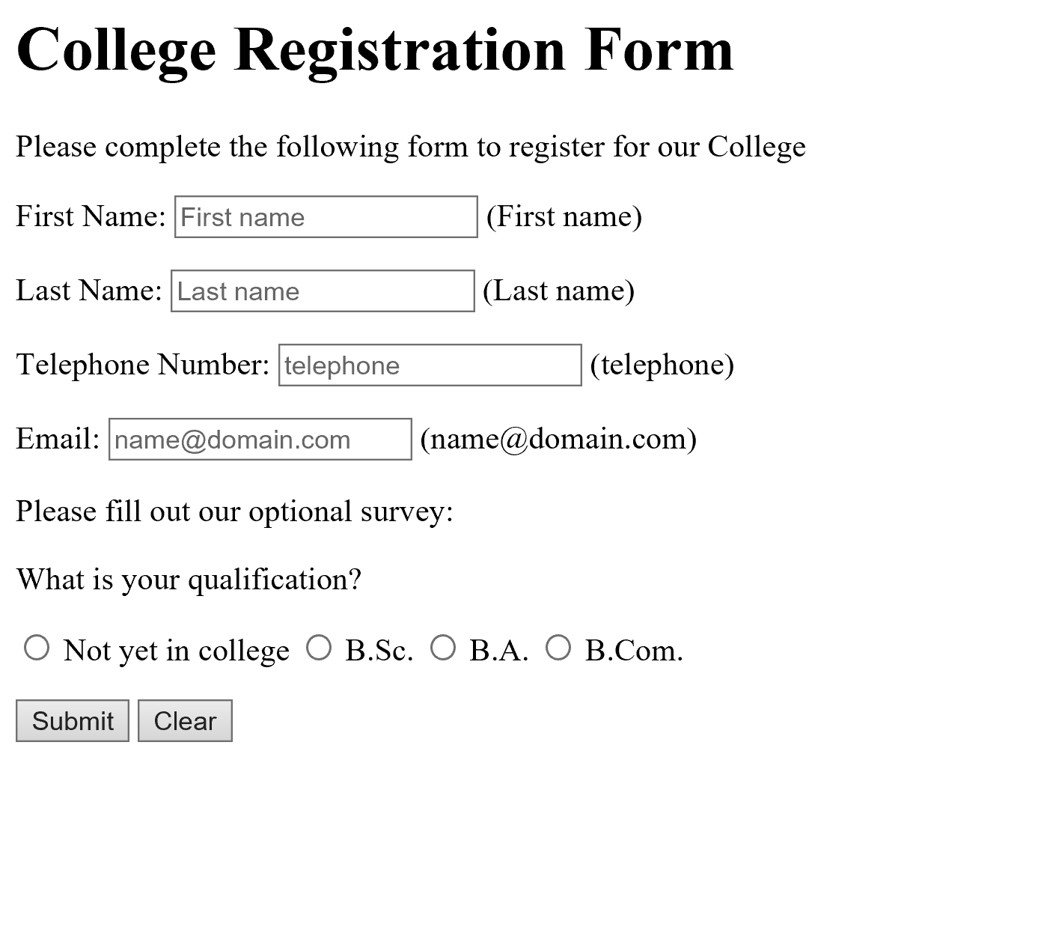
Lab 3-1
Use CSS3 to decorate and validate the College Registration Form developed in Lab 2-1

Slide 3
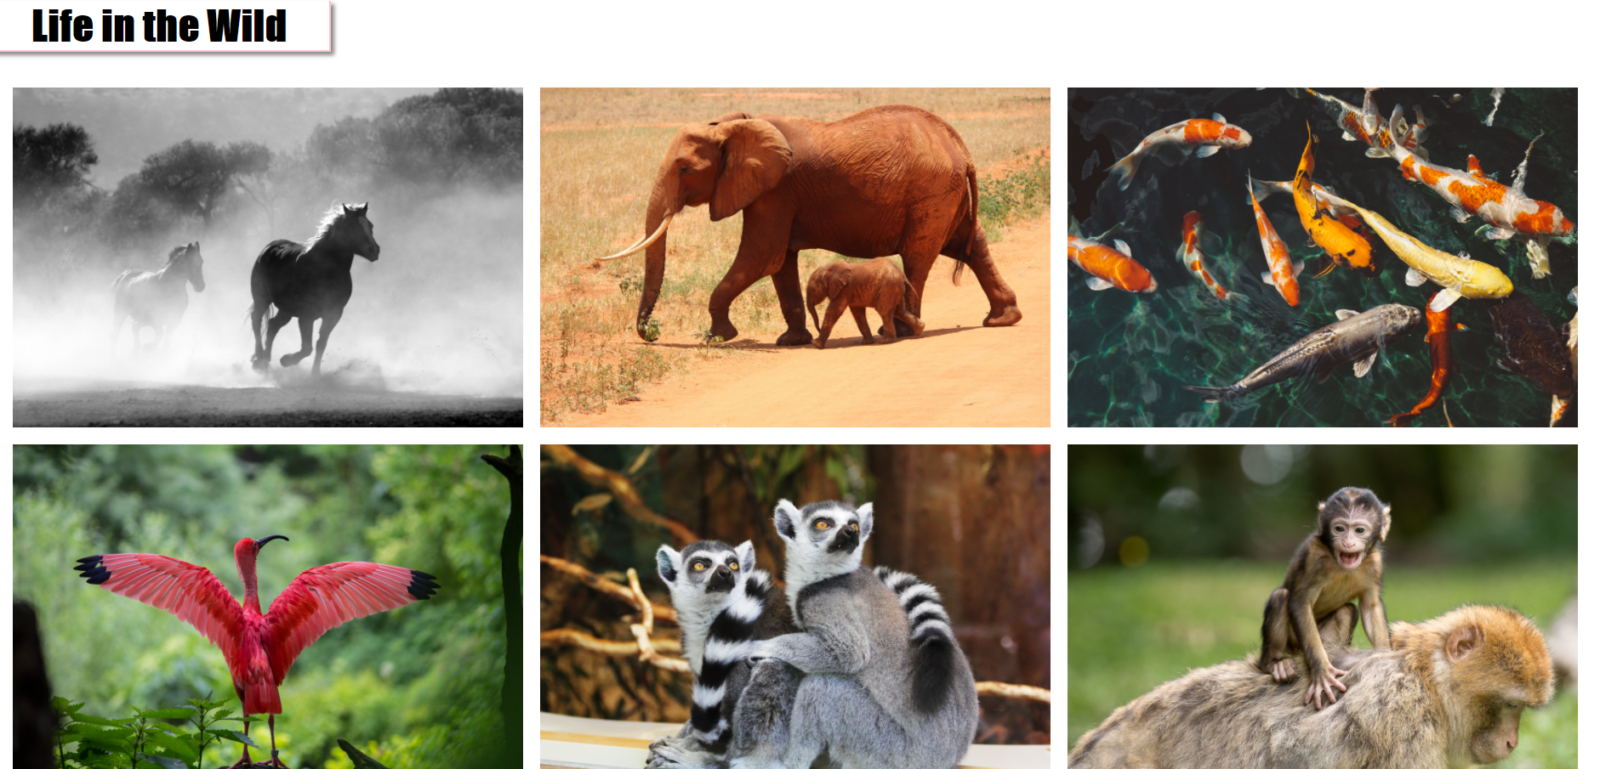
Lab 3-2
Write an HTML5 document with CSS file to render the images (in Image_gallary directory)

